Slide 1
Cloud computing and IoT
Dr. Bhawana Rudra
NITK

Slide 2
IoT generates a lot of data
-Data is generated continuously
-The amount of data increases with device population
-Data sources are highly distributed
-Data sources are on the move
-Data can become stale fairly soon
-Data location will depend on application Data needs to be accurate, secure and useful

Slide 3
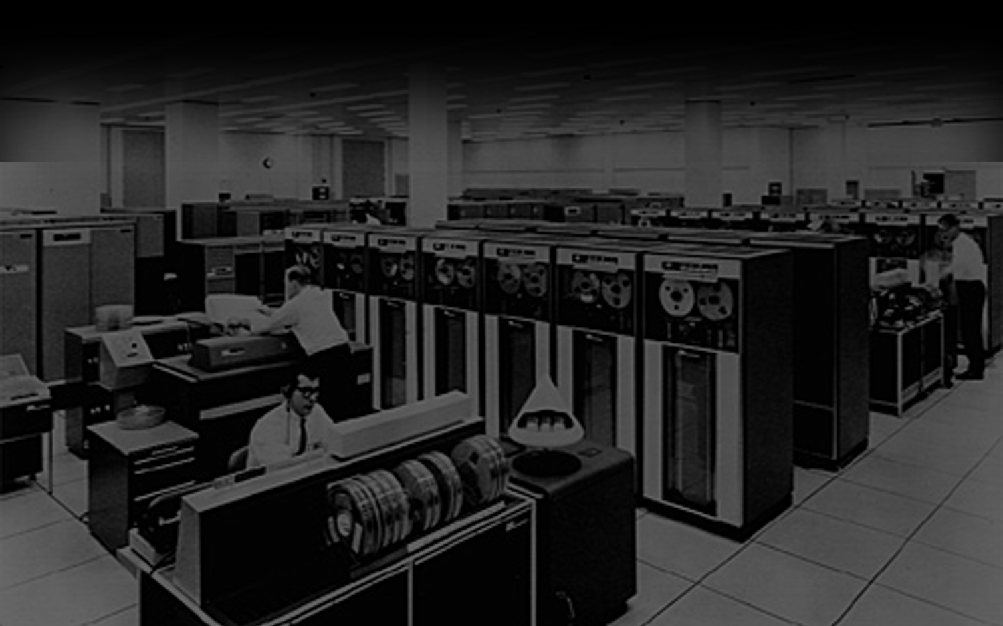
IoT/Fog
Cloud
Disruptor: Virtualisation
Web
Client Server
Minicomputer
Mainframe
1960
1970
1980
1990
2000
2010
2020

Slide 4
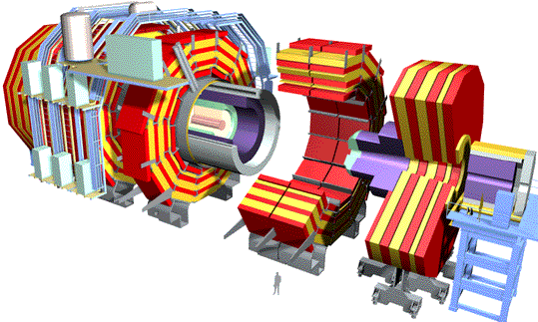
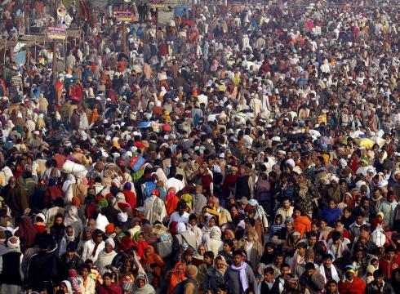
Big Data for
Big Science
Big Data/Clouds for Big Population

Slide 5
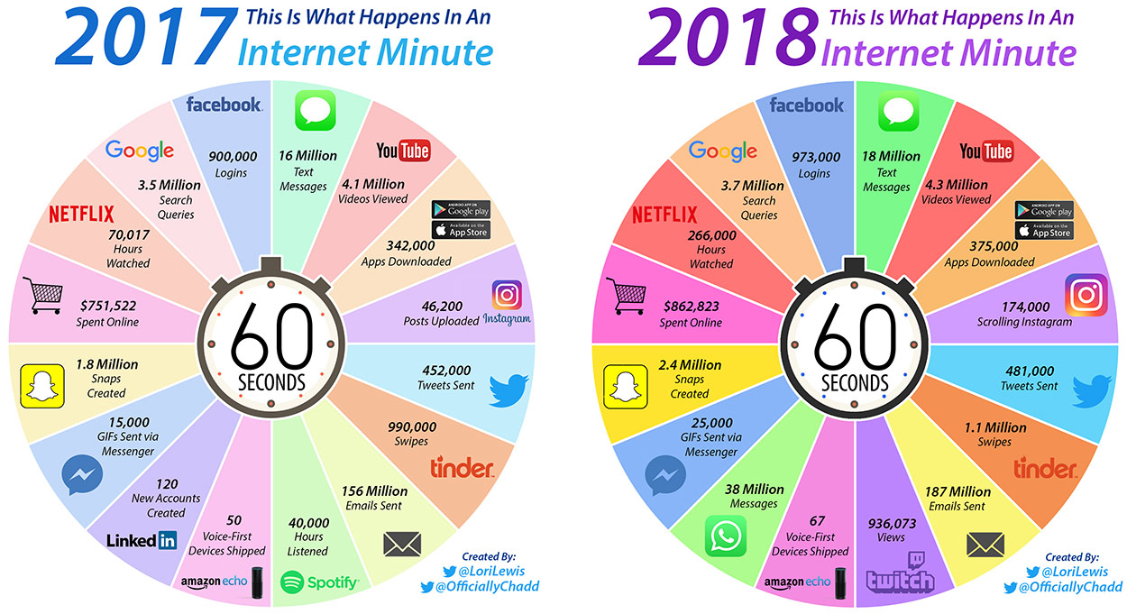

Slide 6
IoT introduces a new concept … Fog Computing
-To handle the large amounts of data in real-time, Fog Computing takes Cloud Computing to the edge of the WAN.
-This eliminates latency and accommodates mobility
-It is also an answer to the large volume of data that is generated and moves it closer to the end-points.
-Facilitates real-time processing and adapts to changing data currency (date getting stale problem)
-Co-exists with Cloud Computing

Slide 7
Cloud computing and IoT:
“Cloud computing is a method for delivery of computing requirements ‘as a service’ to the end user on demand”.
The term cloud theoretically signifies abstraction of technology, resources and its location that are very vital in building integrated computing infrastructure (including networks, softwares, applications etc).
Cloud can be built in many ways. Most common and famous method is by using Virtualization.

Slide 8
Virtualization:
‘Virtualization’ is the process of creating a virtual environment on an existing server to run your desired program, without interfering with any of the other services provided by the server or host platform to other users.
The Virtual environment can be a single instance or a combination of many such as operating systems, Network or Application servers, computing environments, storage devices and other such environments

Slide 9
Benefits of Virtualization:
Numerous benefits are provided by virtualization which includes reduction in costs, efficient utilization of resources, better accessibility and minimization of risk among others.
Benefits for Companies:
Removal of special hardware and utility requirements
Effective management of resources
Increased employee productivity as a result of better accessibility
Reduced risk of data loss, as data is backed up across multiple storage locations

Slide 10
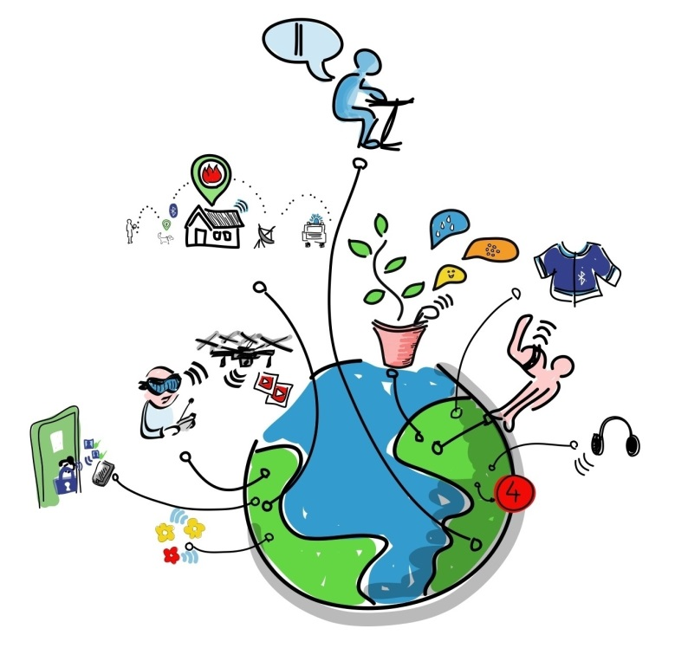
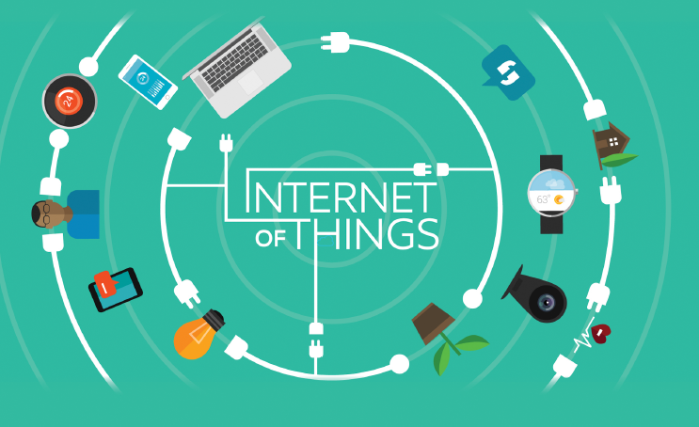
IoT will consist of ~50 billion objects by 2020.
IoT economic impact of $11 trillion/year by 2025.

Slide 11
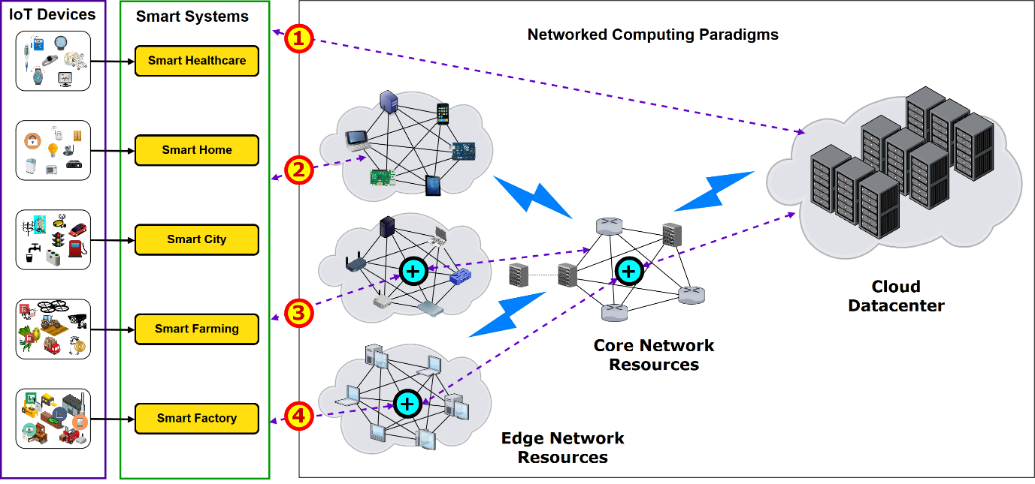

Slide 12
How Does Virtualization Work?
Access to the virtual machine and the host machine or server is facilitated by software known as ‘Hypervisor’.
Hypervisor acts as a link between the hardware and the virtual environment and distributes the hardware resources such as CPU usage, memory allotment between the different virtual environments.

Slide 13
Types of Virtualization:
Hardware visualization
Software visualization
Memory visualization
Data visualization
Network visualization
Desktop visualization
Server visualization

Slide 14
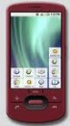
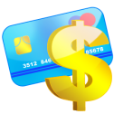
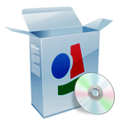


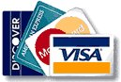

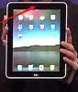
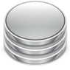
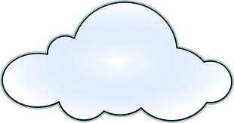

Public Clouds
Applications
Development and Runtime Platform
Compute
Cloud Manager
Storage
Hybrid Cloud
Clients
Private
Cloud
Other
Cloud Services
Govt.
Cloud Services

Slide 15
Types of Clouds:
There are different types of clouds that you can subscribe to depending on your needs. As a home user or small business owner, you will most likely use public cloud services.
Public Cloud - A public cloud can be accessed by any subscriber with an internet connection and access to the cloud space.
Private Cloud - A private cloud is established for a specific group or organization and limits access to just that group.
Community Cloud - A community cloud is shared among two or more organizations that have similar cloud requirements.
Hybrid Cloud - A hybrid cloud is essentially a combination of at least two clouds, where the clouds included are a mixture of public, private, or community.

Slide 16
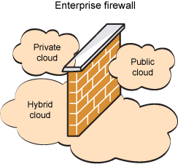
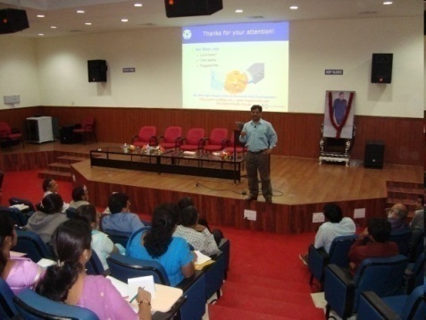

Public/Internet Clouds
Private/Enterprise Clouds
Hybrid/Inter Clouds
3rd party, multi-tenant Cloud
infrastructure & services:
* available on subscription basis
Cloud model run within a company’s own Data Center / infrastructure for internal and/or partners use.
Mixed usage of private and public Clouds: Leasing public cloud services when private cloud capacity is insufficient

Slide 17
Types of Cloud Sevices:
Software as a Service (SaaS) - A SaaS provider gives subscribers access to both resources and applications. SaaS makes it is unnecessary for you to have a physical copy of software to install on your devices. SaaS also makes it easier to have the same software on all of your devices at once by accessing it on the cloud. In a SaaS agreement, you have the least control over the cloud. EX: CPU, Storage: Amazon.com, Google Compute, ….
Platform as a Service (PaaS) - A PaaS system goes a level above the Software as a Service setup. A PaaS provider gives subscribers access to the components that they require to develop and operate applications over the internet. EX: Google App Engine, Microsoft Azure, Manjrasoft Aneka..
Infrastructure as a Service (IaaS ) - An IaaS agreement, as the name states, deals primarily with computational infrastructure. In an IaaS agreement, the subscriber completely outsources the storage and resources, such as hardware and software that they need. EX:SalesForce.Com

Slide 18
Security and Privacy
It is the biggest concern about cloud computing. Since data management and infrastructure management in cloud is provided by third-party, it is always a risk to handover the sensitive information to cloud service providers.
Although the cloud computing vendors ensure highly secured password protected accounts, any sign of security breach may result in loss of customers and businesses.

Slide 19
Benefits
Cloud Computing has numerous advantages. Some of them are listed below –
One can access applications as utilities, over the Internet.
One can manipulate and configure the applications online at any time.
It does not require installing software to access or manipulating cloud application.
Cloud Computing offers online development and deployment tools, programming runtime environment through PaaS model.
Cloud resources are available over the network in a manner that provide platform independent access to any type of clients.
Cloud Computing offers on-demand self-service. The resources can be used without interaction with cloud service provider.
Cloud Computing is highly cost effective because it operates at high efficiency with optimum utilization. It just requires an Internet connection
Cloud Computing offers load balancing that makes it more reliable.

Slide 20
The roles of cloud computing in the Internet of Things revolution:
The IoT is generating an unprecedented amount of data, which in turn puts a tremendous strain on the Internet infrastructure.
As a result, companies are working to find ways to alleviate that pressure and solve the data problem.
Cloud computing will be a major part of that, especially by making all of the connected devices work together.
Cloud computing and the IoT both serve to increase efficiency in our everyday tasks, and the two have a complimentary relationship. The IoT generates massive amounts of data, and cloud computing provides a pathway for that data to travel to its destination.

Slide 21
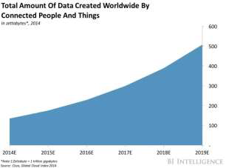
Amazon Web Services, one of several IoT cloud platforms at work today, points out six advantages and benefits of cloud computing:

Slide 22
Variable expense allows you to only pay for the computing resources you use, and not more.
Providers such as AWS can achieve greater economies of scale, which reduce costs for customers.
You no longer need to guess your infrastructure capacity needs.
Cloud computing increases speed and agility in making resources available to developers.
You can save money on operating data centers.
You can deploy your applications worldwide in a matter of minutes.
Some of the more popular IoT cloud platforms on the market include Amazon Web Services, Google Cloud IoT, Microsoft Azure IoT Suite, IBM Watson, and Salesforce IoT Cloud, Thingspeak.

Slide 23

Cloud Computing Challenges
Pricing
Virtualization
Scalability
Resource Metering
QoS
Reliability
Service Level
Agreements
Billing
Energy Efficiency
Provisioning
on Demand
Utility & Risk Management
Legal & Regulatory
Security
Privacy
Programming Env. & Application Dev.
Uhm, I am not quite
clear…Yet another
complex IT paradigm?
Trust
Software Eng. Complexity

Slide 24
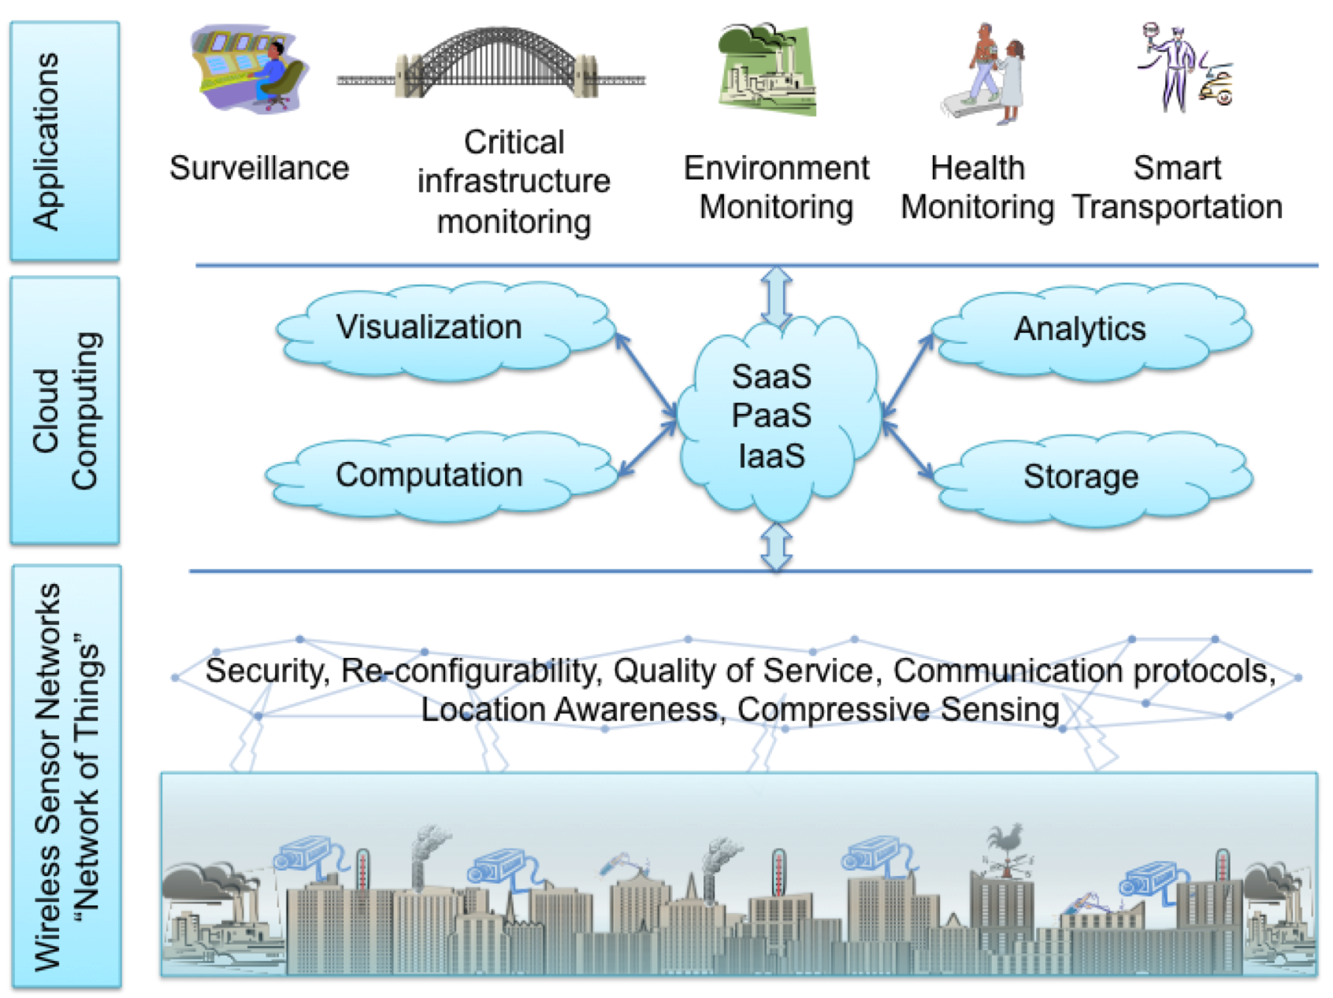
Cloud-centric IoT Framework (for Smart Cities)

Slide 25
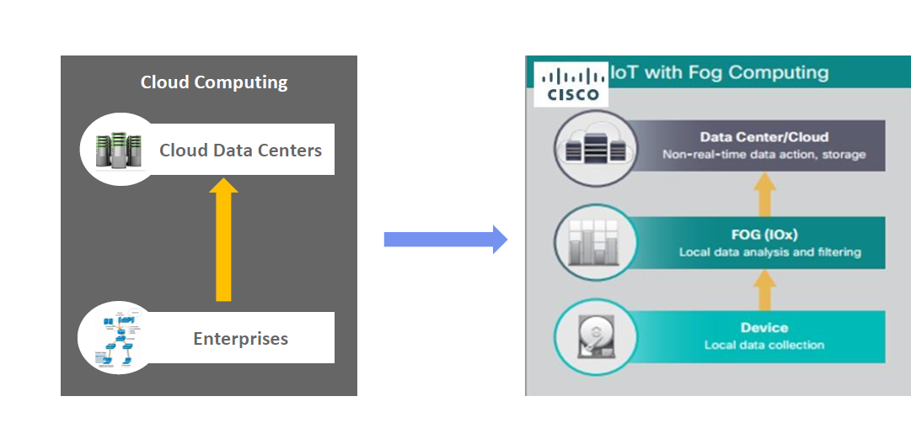
IoT Fog/ Cloud Solution

Slide 26
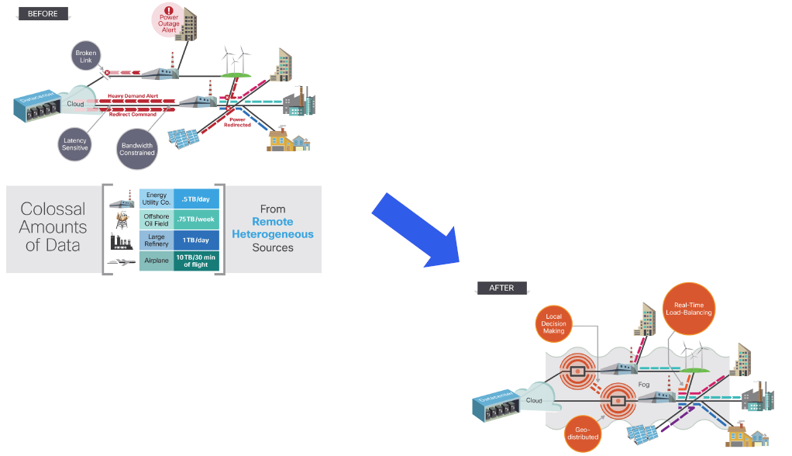
Why Fog Computing

Slide 27
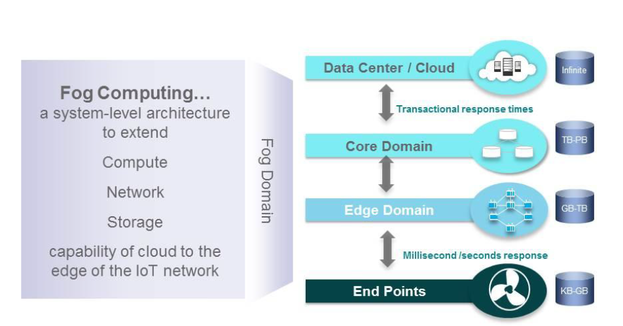
Fog Computing Extends Cloud Computing

Slide 28
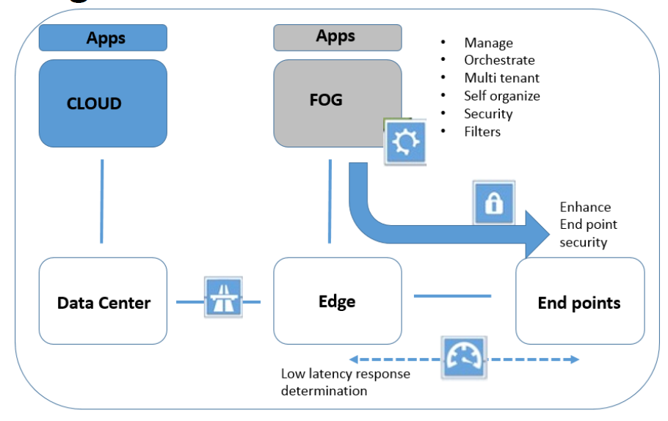
Role of Fog

Slide 29
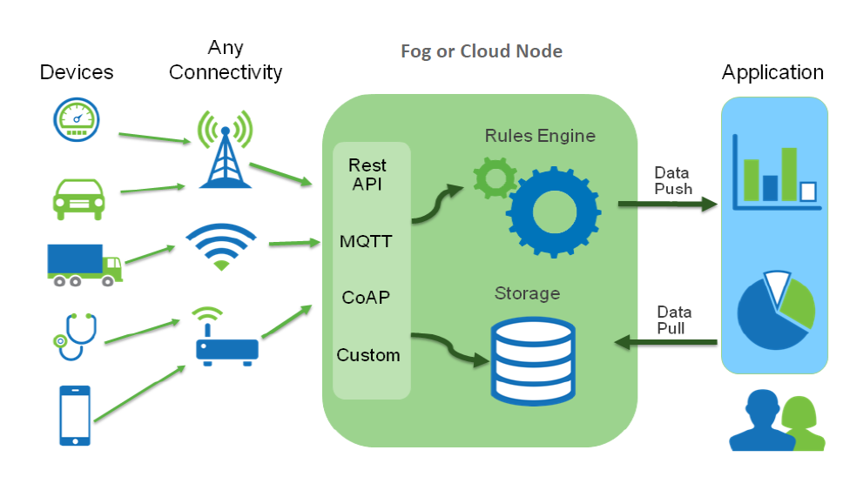
IoT Data Collection System

Slide 30
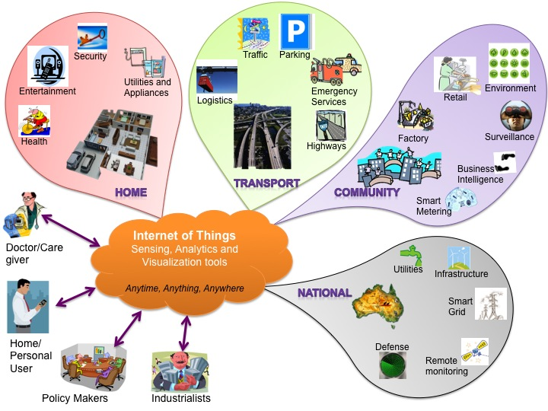
IoT (Internet of Things) Cloud for Smart Cities – City of Melbourne

Slide 31
